Slide 1
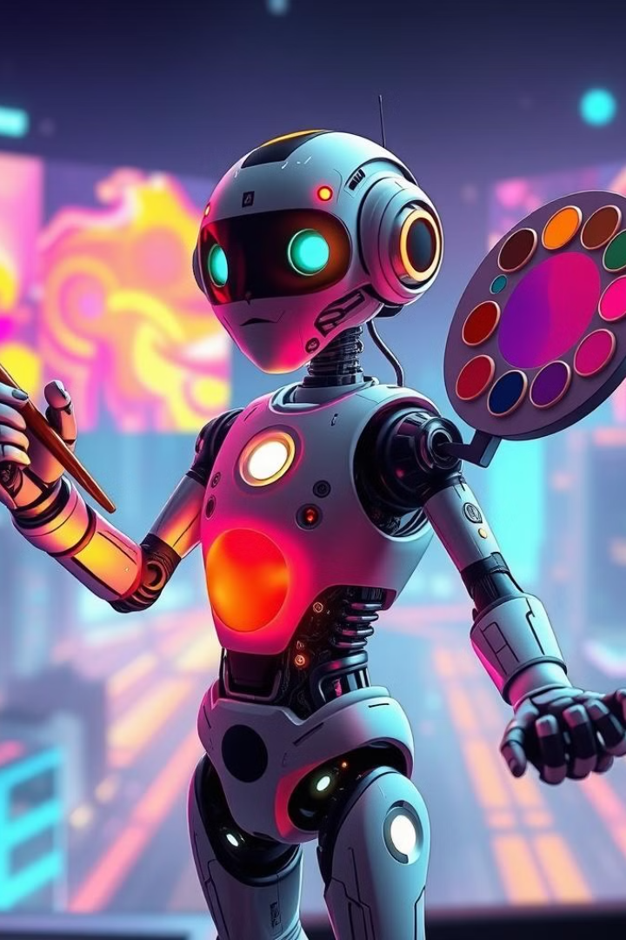


Generative AI: Creating the Future
Notes:
1.7.2013
1
‹#›

Slide 2
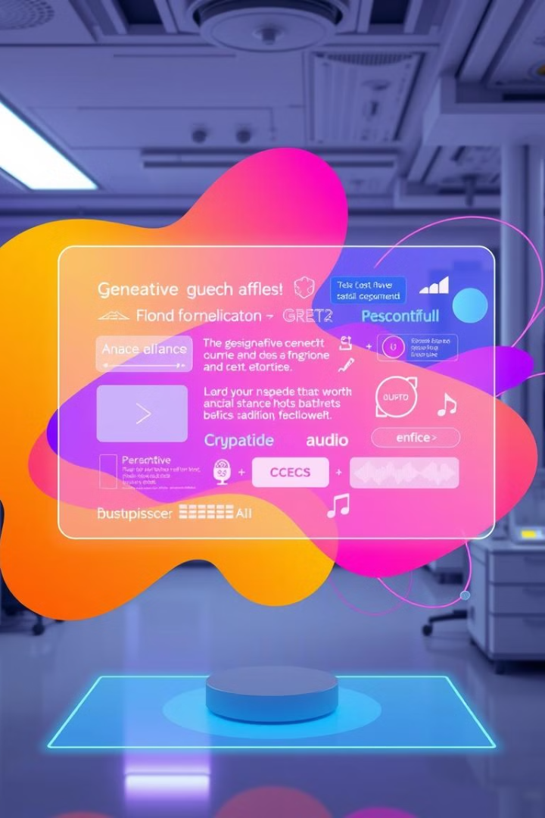
What is Generative AI?
Definition
Examples
AI that creates new content, including text, images, audio, video, and code.
DALL-E, Stable Diffusion, ChatGPT, Bard.
Use Cases
Creative writing, artwork, music, video game development, and more.
Notes:
1.7.2013
2
‹#›

Slide 3
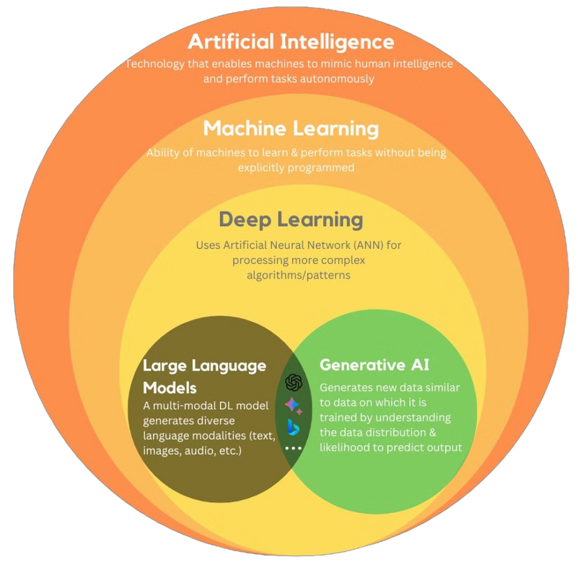
Generative AI is the subset of Deep Learning
Notes:
1.7.2013
3
‹#›

Slide 4
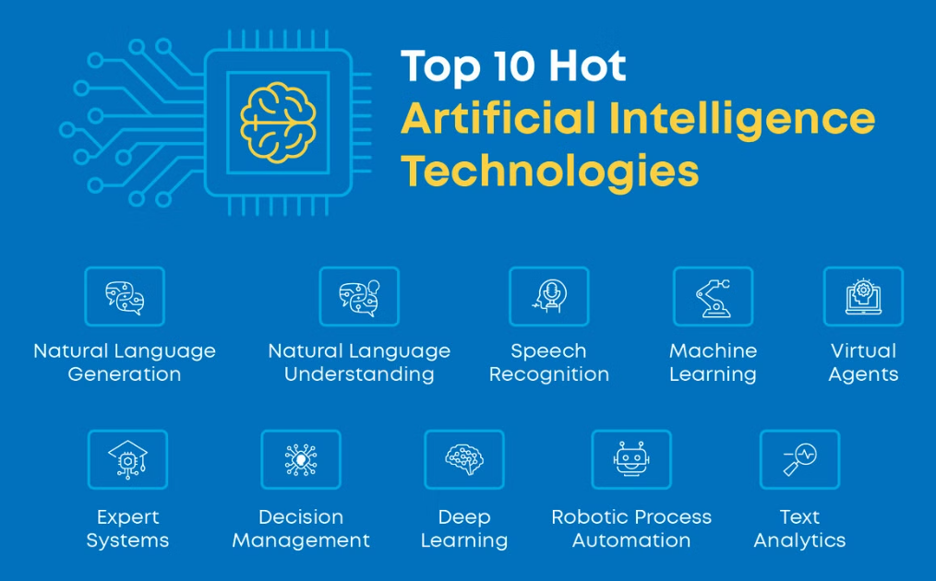
Artificial Intelligence
Artificial Intelligence (AI) is the ability of computers and machines to perform tasks that usually require human intelligence. This includes learning from data, recognizing patterns, solving problems, and making decisions. AI powers things like virtual assistants (Siri, Alexa), chatbots, self-driving cars, and recommendation systems (Netflix, YouTube). It works using techniques like machine learning and deep learning to improve over time without human intervention.

Slide 5
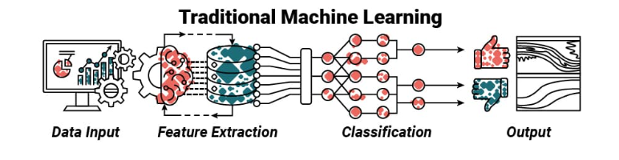
Machine Learning
Machine Learning (ML) is a branch of AI that enables computers to learn from data and make predictions or decisions without being explicitly programmed. Instead of following fixed instructions, ML models find patterns in data and improve their performance over time.
⚙️ How It Works
Data Collection → Model Training → Prediction → Improvement
📌 Types of ML
Supervised Learning – Uses labeled data (e.g., spam detection)
Unsupervised Learning – Finds patterns in unlabeled data (e.g., clustering)
Reinforcement Learning – Learns through trial and error (e.g., self-driving cars)
🚀 Applications
Recommendation Systems (Netflix, YouTube)
Fraud Detection (Banking)
Healthcare (Disease Prediction)
Image & Speech Recognition

Slide 6
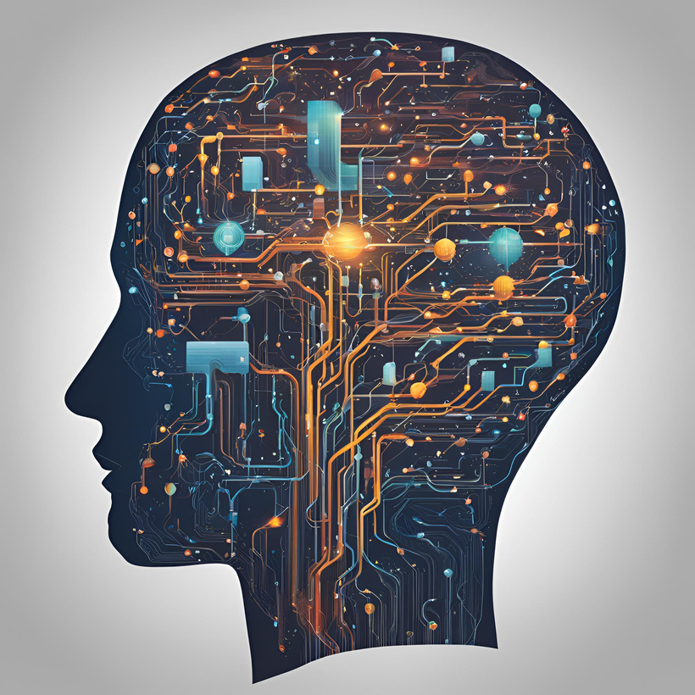
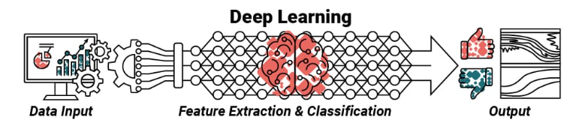
Deep Learning
Deep Learning (DL) is a subset of Machine Learning that uses artificial neural networks to mimic the human brain and process complex data.
⚙️ How It Works
Uses multiple layers of artificial neurons to analyze and learn from large amounts of data.
📌 Key Features
Multi-layered neural networks (Deep Neural Networks)
Automatic feature extraction (No need for manual feature selection)
Improves with more data
🚀 Applications
Image & Speech Recognition (Face ID, Siri)
Autonomous Vehicles (Self-driving cars)
Healthcare (Disease Detection)
Natural Language Processing (Chatbots, Google Translate)
⚠️ Challenges
Requires massive data & computation
Hard to interpret (“Black Box” nature)
Can be expensive to train

Slide 7
LLM
Prompt Engineering
RAG
Fine-Tuning
AI Agent
Notes:
1.7.2013
4
‹#›

Slide 8
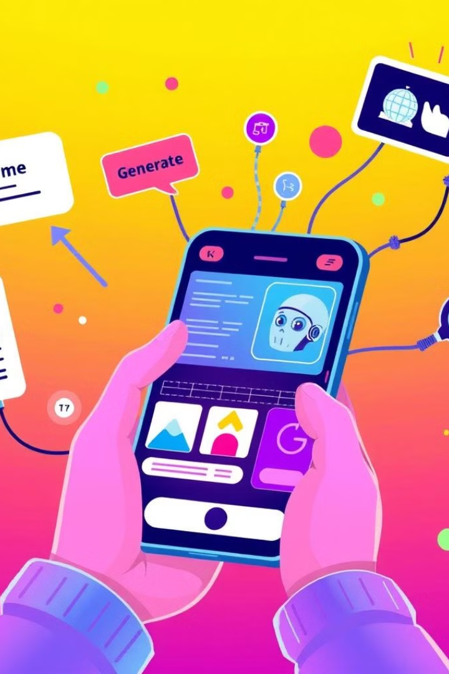
Real World Applications of Generative AI
Text Generation
Image Generation
ChatGpt,Deepseek
MidJourney,DALL·E (OpenAI)
Video Generation
Text to Speech
Runway ML,DeepBrain AI
Amazon Polly,suno ai,iSpeech
Notes:
1.7.2013
5
‹#›

Slide 9
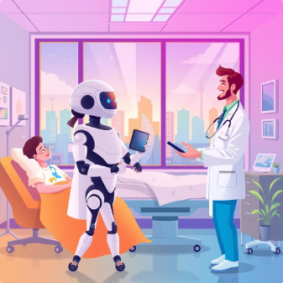
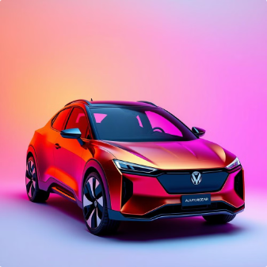
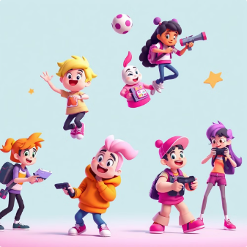

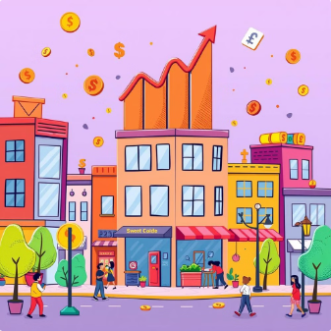
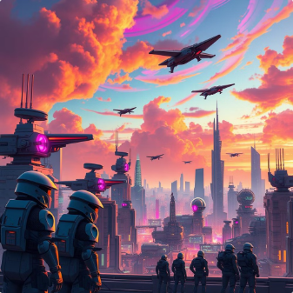
Industry Applications
Healthcare Industry
Automobile Industry
Gaming
Agriculture
Finance
Defence & Military
Notes:
1.7.2013
6
‹#›

Slide 10

AI IN NUMBERS
$294.16 Billion
$13 Billion
Global Market
India's Investment in 2024
AI Jobs Sector
By 2025, the AI industry in India is projected to create approximately 1.3 million jobs
Notes:
1.7.2013
7
‹#›

Slide 11



Replacements by AI
Content Writer
Graphic Design
HR and Recruitment
.
.
.
Notes:
1.7.2013
8
‹#›

Slide 12
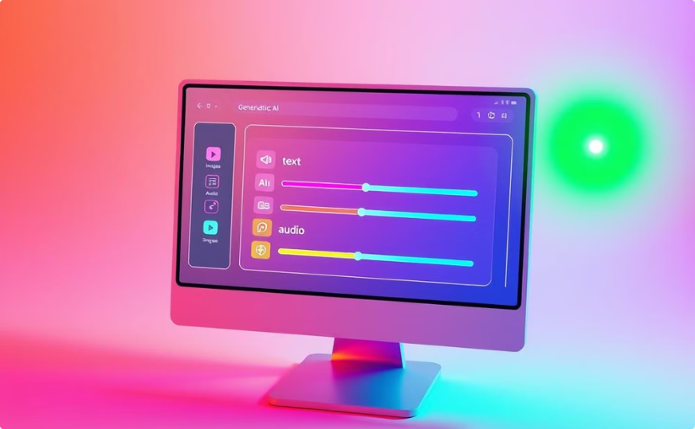
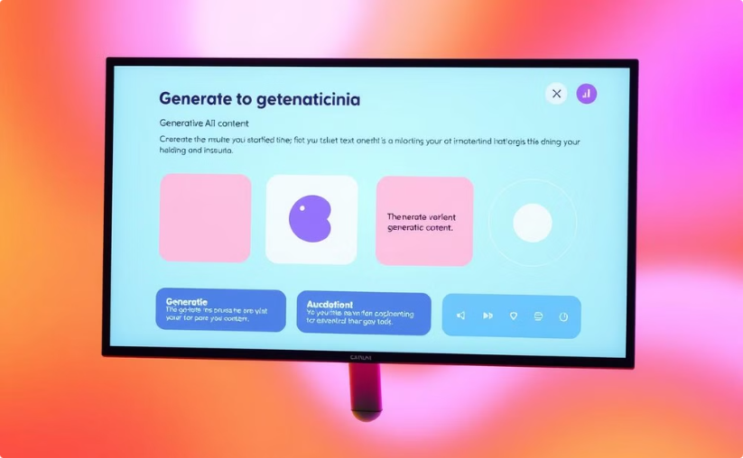
Live Demo: Generate text, images, and other content
Text
Image
Write a poem about a lonely cat.
Generate an image of a futuristic city.
Notes:
1.7.2013
9
‹#›

Slide 13

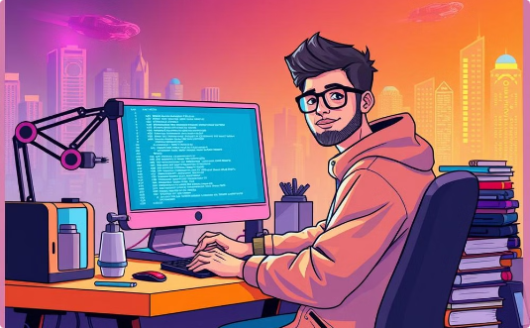
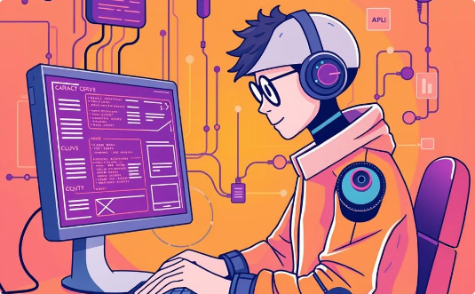
Job Profiles
Data Scientist /Analysis
Prompt Engineer
AI Engineer
A data scientist needs expertise in programming (Python, SQL), statistics, machine learning, data visualization, big data, cloud computing, and business problem-solving. 🚀
Expertise in AI prompt crafting, NLP, LLM fine-tuning, creative thinking, problem-solving, and optimizing AI outputs for accuracy and efficiency 🚀
Skills in machine learning, deep learning, LLM, RAG, Python, TensorFlow/PyTorch, cloud and deploying AI models into production. 🚀
Notes:
1.7.2013
10
‹#›

